Slide 1
One Represent
Find a successful name for your Startup based on given description

Slide 2
Motivation / Goal
Commercial Project: help a business find a great name capturing its mission.
Reasons for choosing this topic
Helping a startup business find a name, based on successful start-ups
A creative never-seen-before result
The ML challenge of generative model (i.e. non-classifying)
An interest in NLP and process of computing semantic meanings of text

Slide 3
Test-Data Examples
TF-IDF
Real Name:
Green Energy Exchange
Input:
we deliver affordable, renewable, energy direct to customers and are creating business to make green energy accessible to everyone.
Output:
Gemstones Energy
Real Name:
MyScoot
Input:
airbnb home hosted social events. we help you meet new people in your city .
Output:
MyRole

Slide 4

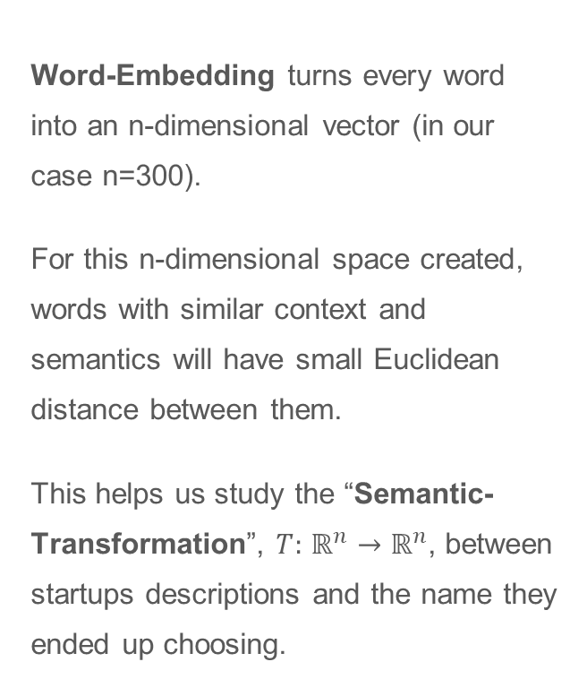
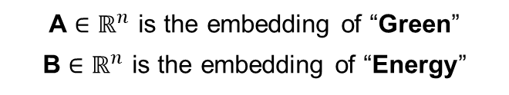
We use Word-Embedding
Word-Embedding turns every word into an n-dimensional vector (in our case n=300).
For this n-dimensional space created, words with similar context and semantics will have small Euclidean distance between them.
This helps us study the “Semantic-Transformation”, $T:$ $ℝ^{n}→ℝ^{n}$, between startups descriptions and the name they ended up choosing.
A
10
Euclidean Distance
B
5
5
10
15
A $∈ℝ^{n}$ is the embedding of “Green”
B $∈ℝ^{n}$ is the embedding of “Energy”

Slide 5
Machine Learning Setup
“we deliver affordable, renewable, energy direct to customers and are creating business to make green energy accessible to everyone.”
AFFORDABLE (0.6, 0.4, -0.8, ... , 0.9)
RENEWABLE (0.5, -0.2, 0.8, ... , 0.1)
GREEN ENERGY (0.5, -0.2, 0.8, ... , 0.1)
WEIGHTED AVG (0.5, 0.0, 0.3, ... , 0.4)
GEMSTONE
(1.2, 2.0, 0.7, ... , -0.5)
ENERGY
(2.3, -0.2, 0, ... , 3.2)

Slide 6


Machine Learning Setup
Short description of Startup
Startup
Name
TF-IDF
Assessment
Word Vector
$$ℝ^{300}$$
GloVe
Second Word = Weighted Mean - Word Vector
Embedment
*
Model
Weighted mean
Template selection:
1-word / 2-words
$$ℝ^{300}$$
* Linear Regression gave best results for words with significant context from the description (>KNN)

Slide 7

Results
26% of generated names
Real Startup Name
Distance
0 - 6.5
The model accurately predicted at least one of the words generated for 5% of the cases.
79% of names generated have a strong semantic context to the actual name of the company.
The illustration on the right shows the context between the real company and the name given, using their embedding’s Euclidean distance.
Distance
6.5 - 9
53% of generated names
Distance
10+
Distance
9 - 10
15% of generated names
6% of generated names

Slide 8
Weird Results Examples
TF-IDF
Input:
universal reconciliator software that extracts cleans normalizes filters and reconciles transactions to maintain trusted source of truth transactional data focus on making it useful through accurate reports and integrations
Output:
Micro Labs
Real Name:
Simetrik
Input:
provides instant answers to students' test prep questions and makes test prep faster and cheaper any private tutor
Output:
Pagina
Real Name:
Kunduz

Slide 9
Test Examples
TF-IDF
Input:
Plant growing tips application, designed to help you with growing your own vegetation at home environment.
Output:
Your Plants
Input:
Find a suitable name for your Startup based on given description
Output:
One Represent

Slide 10
Data collection / data processing
Data: ~1,600 startup names + their description, scraped from ycombinator.com
About the Features
The coordinates extracted from the weighted average of the embeddings of the most significant words of the startup description and their TF-IDF score.
About the Labels
The coordinates extracted from embedding the real words found in startup names.
Training and Testing
Two thirds for training, one third for testing.

Slide 11
Future work
Make adjustments to the name found (distort, mix with another word, use capital letters).
Make up names from scratch (not from a dictionary or wiki).
Create smarter solution for choosing a template.
Cooperate with Shani Getz’s project to create a full package for a start-up, including a name and a logo.

Slide 12
Comments?

